Slide 1
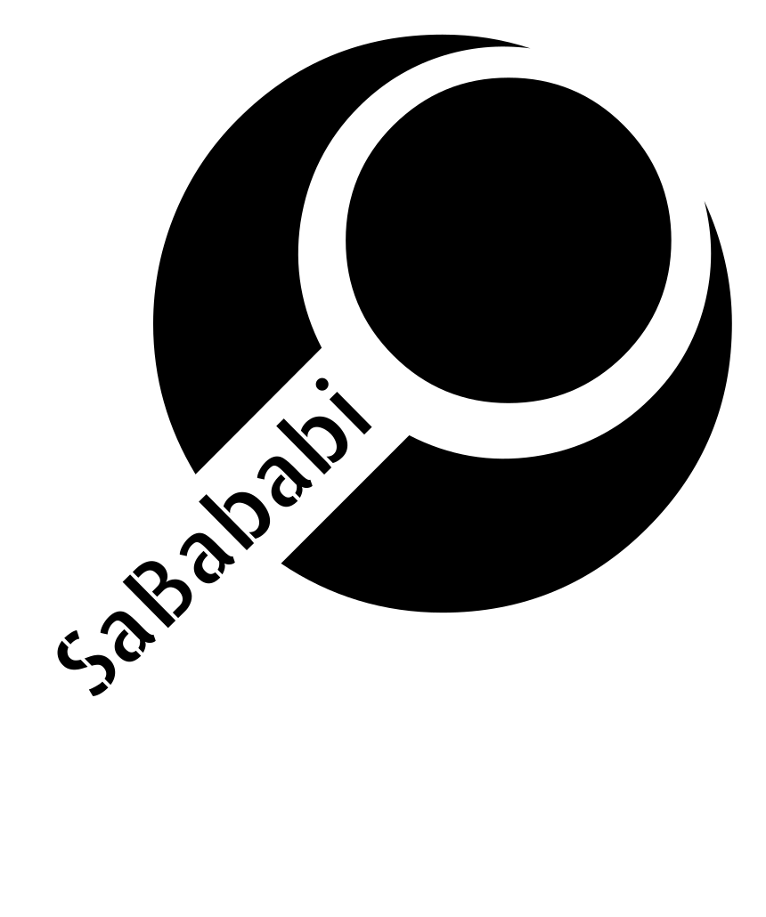

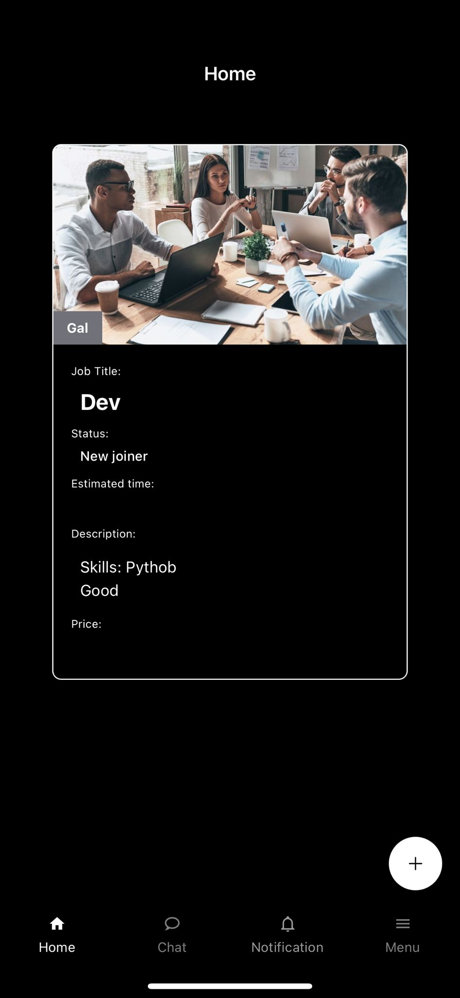
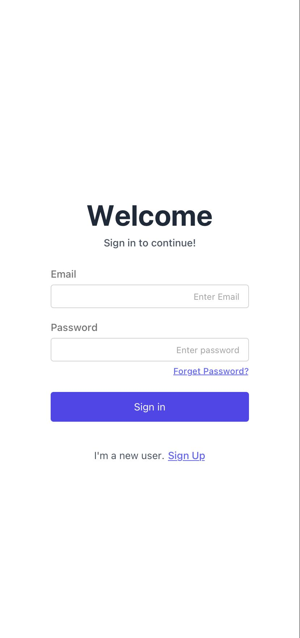
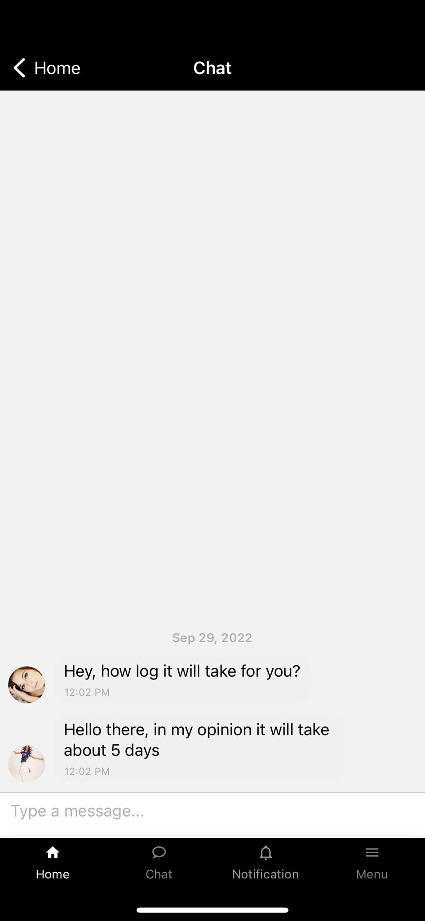
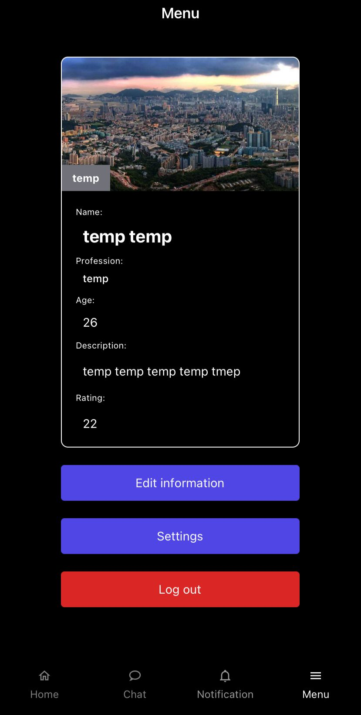



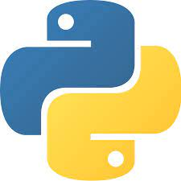
Sababi The easiest way to find a job
Gal Bachar, Shahar Baba, Eden Meshulam, Daniel George Lecturer: Tal Gomay
Today, there is a high demand and many fundraisers of resources for all types of jobs and for high-tech in particular. Almost every company is looking for employees, and also there are lot of private people or freelancers that looking for full time job or part time job. The market today is difficult, and it is hard to find a candidate that fit the requirements of the company, so there is a high need to look candidates. Project Goal : Our goal is to develop a useful application for companies , freelance and people who looking for job to make their life easier by using our to find the best match for them.
The Project
System Screenshots
Schema
Schemas
If the users don’t register
Start application
Login page
Register Flow
If the users already register
Main Page - Workers
Main Page – Companies / Employers
Technologies
Docker
React Native
JavaScript
Python
If the users reject the offer
If the users accept the offer
Chat page
If the users reject the offer

